Slide 1


Inside Lives
Longitudinal qualitative community of citizens and small business owners
Bulletin 8 (24/06/2020)
Views on flexible working after lockdown
Kantar’s Public Division UK

Slide 2
Inside Lives is a longitudinal qualitative study created by Kantar to offer our clients rapid access to a rich qualitative understanding of public experiences, feelings and beliefs during the COVID-19 crisis.
In this bulletin we look at attitudes and expectations around flexible working after lockdown
  Please get in touch to discuss any of the issues covered in this bulletin in greater depth
2

Slide 3



Community members take part in three weekly tasks
Temperature
check tracking
and diary activities
Thematic
community activities
Topical message
board discussion
Findings in this document are drawn primarily from tasks conducted in w/c 15th June

Slide 4

Concerns about the economy have remained consistently high
Despite a slight fall in the strength of sentiment immediately following the announcement of plans to relax lockdown measures, concerns about the economy have returned to a consistently high level across the course of the community
Announcement UK is “past the peak”
Announcement re: reopening of non-essential shops
4

Slide 5

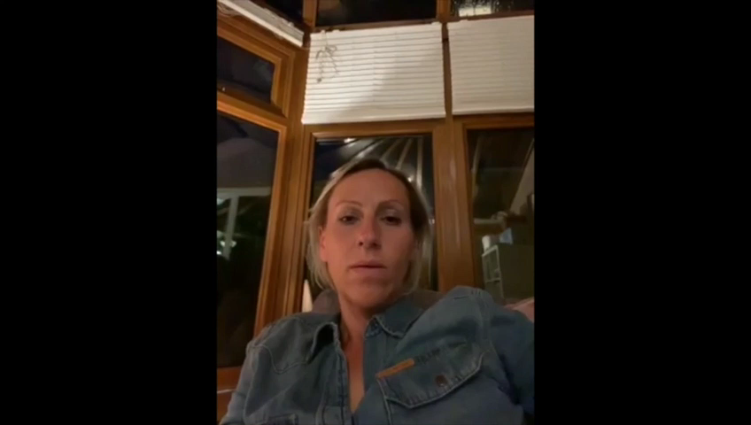
The pandemic presents a mix of opportunities and challenges for work
Whilst some participants are appreciative of new opportunities for home working, for many others economic impacts continue to loom large and need for social distancing creates more challenging working conditions
  For many of those who have been able to work remotely, the experience has created a sense of increased flexibility and there is a desire to continue this to some extent into the future
  In some sectors, such as travel and events, economic concerns are more acute and remote working is associated with cost-cutting for businesses as well as with flexibility for employees
  For some of those in customer-facing jobs who have now returned to work, social distancing measures are reducing flexibility and introducing stressful new processes
  A number of panellists are still unsure about when they will be able to return to work, and are more concerned with securing work again then flexibility
04:05
Click video to play
5

Slide 6
Remote working is seen to present opportunities for better quality of life
Most of those that are remote working realise a range of benefits and want to continue in some way following lockdown, but are waiting for guidance from employers and government
“
  For those able to work remotely, the primary benefit was seen to be a better sense of work / life balance and integration of work with life
  A number also pointed out wider benefits relating to a reduction in traffic and pollution due to commuting, cost-saving for employers, and - in the current context - safety
  Remote working was also seen to present new challenges, particularly including the risk of social isolation, the difficulty of finding a suitable place to work and a lack of clear boundary around work
  In all then, most hoped for a switch from an ‘office’ default to a mix of office and home-based work following lockdown, given that experiences had ‘proved’ that home working could work
  However, the extent to which this was seen as possible was felt to be down to businesses, with little sense yet of any official changes in policies for flexible working following lockdown
  Many also expected government to take the lead here to support businesses, especially given the potential wider environmental benefits
If it is type of job which can be done at home then it is a matter of properly organising it, and of management being agreeable. Until now, for me, it was not possible to work from home and then, company was forced to allow people work from home and it showed that it is possible, all work is done, staff are happier so it is an eye opener for a lot of companies, and I am sure they will now consider new options, working from home, flexible hours.
Female, 60+, London
I think we now have a small window to make some really big changes to the work environment. I think this can't be left to businesses, the guidance and advice has to come from the govt for businesses to really change.
Male, Family, London
02:55
6

Slide 7



On discussion boards, the community discussed a four day work week
The current moment was seen as an opportunity to experiment with new ways of working and most were supportive if productivity can be retained
I used to do condensed hours in my old job and work full time over 4 days. I had the other day with my daughter and it was great. It might be the ideal time to reassess things and who knows it might actually benefit some people. Obviously industry dependant...
Female, Family, South-west
If productivity has gone up and stays up more importantly then it seems like a no brainer. It would be great if people had that flexibility and it would make such a difference in regards to child care. For us it would be great if my husband could work a 4 day week and be paid the same. It would mean that we wouldn’t have to use after school club when I am at work one day so it would benefit us financially.
Female , Family, South West
I’d go further. Remove weekends and bank holidays and allow employees to take as much time off as they want .....as long as the job gets done. The idea of a Monday clock on and Friday clock off is so Victorian. Getting rid of these artificial time structures would remove the rush hour, even out traffic flows and reduce pollution.
Male, Family, London
7

Slide 8

Upcoming topics
New activities launch every Friday and run for a week
  Bulletin 9: Looking back and looking forward
  Please get in touch to discuss any topics or issues that you would like to see explored with the community in future weeks
8

Slide 9
Inside Lives offers rapid access to a rich qualitative understanding of public experiences, feelings and beliefs during the Covid-19 crisis
Measures taken to prevent the spread of Covid-19 present new challenges for policy makers needing to respond rapidly to changing conditions.
Inside Lives offers a bridge between policy-makers and those they represent at a time when face-to-face research routes have become impossible.
Inside Lives is an ongoing online community of 50 individuals to provide longitudinal qualitative insight into responses to the pandemic.
Coverage includes a diverse range of life stages and relevant circumstances – including those who have lost work, key workers in health & education and those living alone – as well as 10 SME owners drawn from a variety of sectors.
It offers fast-turnaround access to experiences, behaviours, feelings and beliefs of people living with, and looking beyond, Covid-19.
We collect insight via individual tasks to illuminate personal stories and moderated activities to deepen understanding of issues such as home-schooling, flexible working, travel, food practices, and attitudes to sustainability.
We engage participants via regular tracking measures and video diaries, alongside weekly bespoke community activities and discussions.
Participants log on twice each week for at least 30 minutes to engage with tasks, moderator probes, and other community members. Reporting is powered by our expert qualitative analysis, and brought to life via video and other multimedia material.
Alongside these free weekly bulletins, we also offer curated access to the panel on a weekly basis and bespoke analysis for your topic of interest.
Curation of the panel for one week, with custom-designed activities and outputs delivered in as little as 2-3 weeks, is available from only £8,275
In-depth analysis of non-curated weeks is available from £2,800 (excl. VAT)
Email our team to find out more

Slide 10
About Kantar
Kantar is the world’s leading evidence based insights and consulting company. We have a complete, unique and rounded understanding of how people think, feel and act; globally and locally in over 90 markets. By combining the deep expertise of our people, our data resources and benchmarks, our innovative analytics and technology, we help our clients understand people and inspire growth.
Kantar’s Public Division is the global leader in public policy research, evaluation and consultancy.
@Kantar
www.kantar.com
Nick Roberts
nick.roberts@kantar.com
07521 605 793
Amy Busby
amy.busby@kantar.com
020 7656 5949
Kantar’s Public Division UK | 4 Millbank, Westminster, London, SW1P 3JA | www.kantar.com

